Slide 1
Search Book
David Dong

Slide 2
Build an Book search app using Angular & Angular Material
Basic requirement: Two page we have: Home, Show Wishlist. User can switch page in toolbar, Default page should be Home.
Home page:
Create a Search Bar for User to input an bookname to search books.
Expected every input typing in the search input should send request to backend, try to improve the performance and UX by using debounceTime.
List books in the Booklist, each book as a card, each card should contain
book pickture,
book name,
publisher,
publish date,
description.
(if any info not list in the response json, do not show it in your card.)
Click a book card can add this book into Wishlist.
Wishlist only list books name, user can delete book from the Wishlist by click delete button for each book.
Show Wishlist page:
Show book name lists in Home page wishlist.
API URL: https://www.googleapis.com/books/v1/volumes?q=bookname
Service: Create an book Service to fetch and maintain info about for books.
Style: Make up your page with Angular Material.

Slide 3
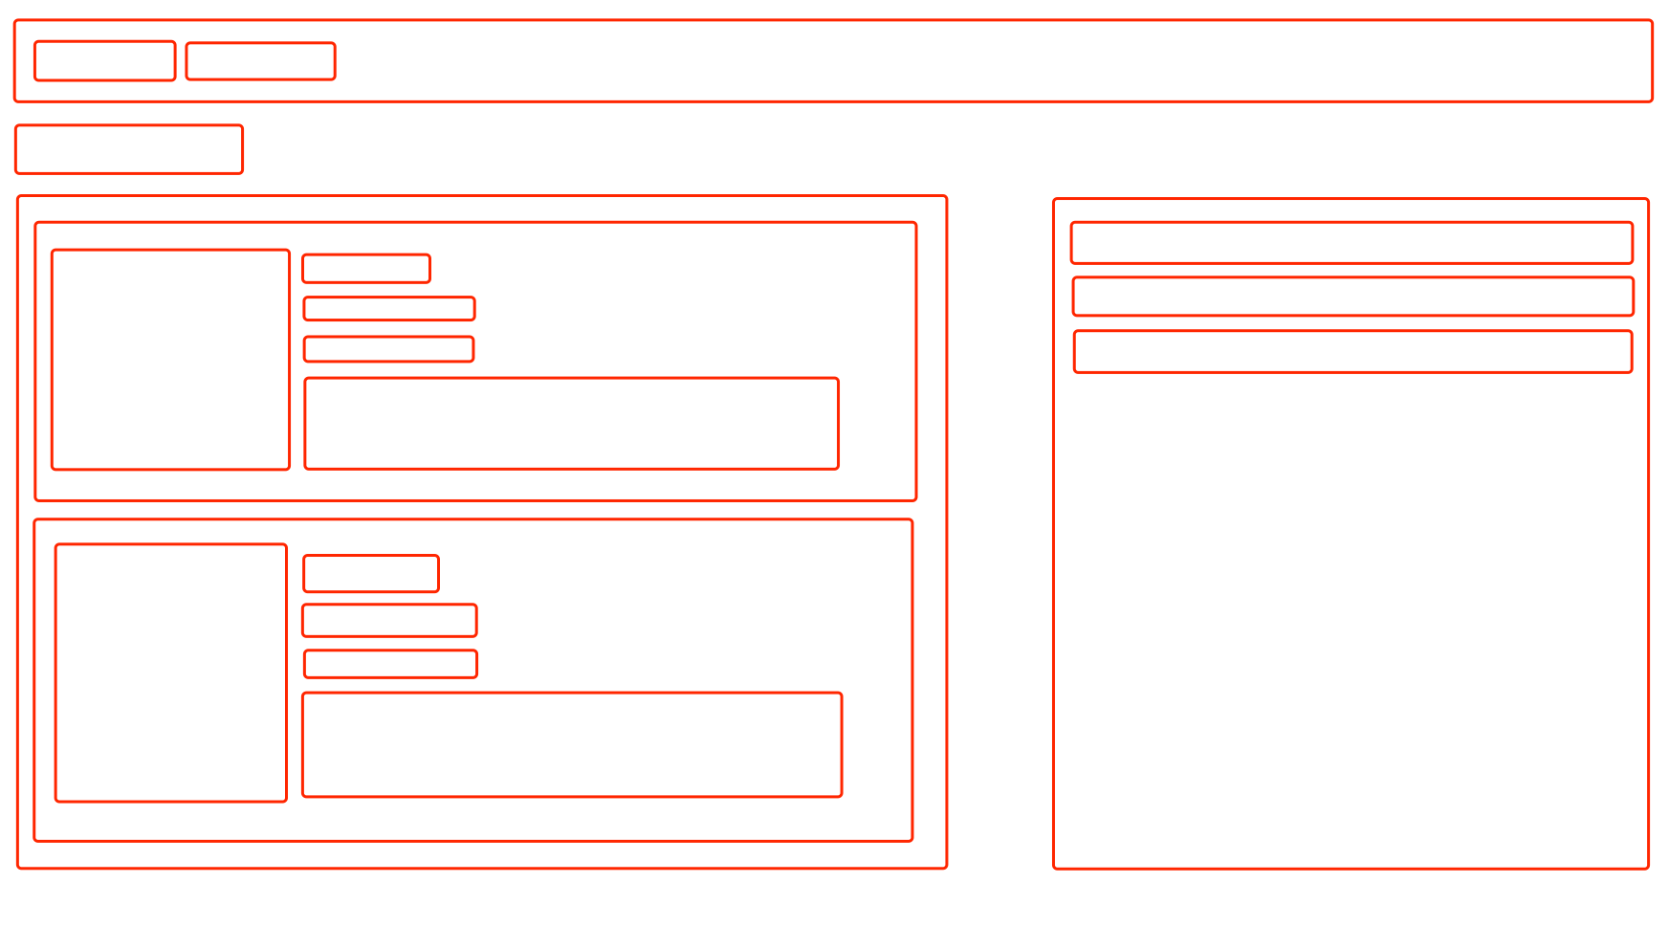
Home Page
Home
Show Wishlist
Search input
Book name
delete button
book pickture
book name,
publisher,
publish date,
description.
Booklist
Wishlist

Slide 4

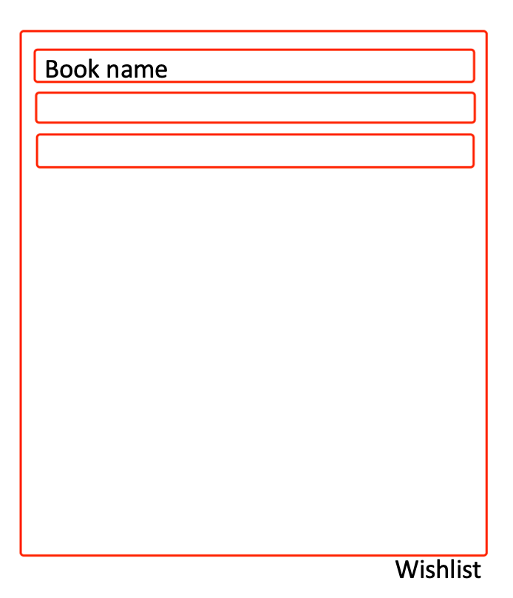
Show Wishlist Page
Home
Show Wishlist

Slide 5
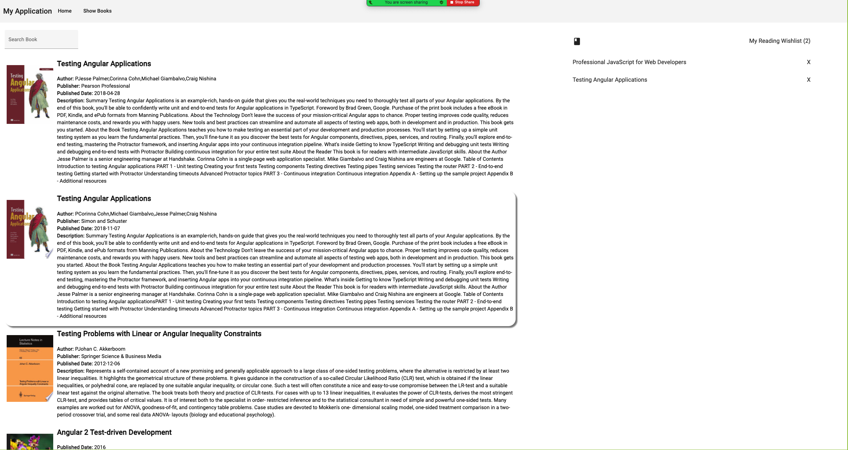

Slide 6
